Slide 1
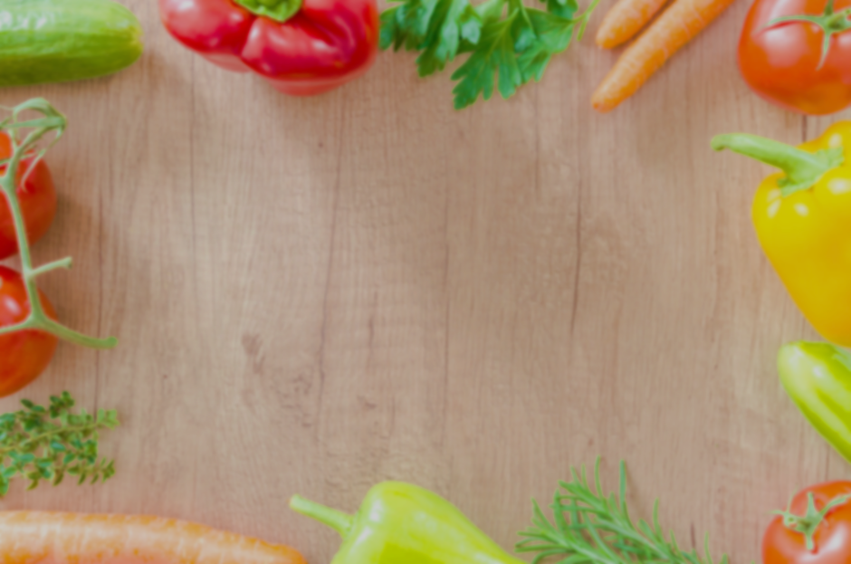
Cherry Tree Primary School Menu
Summer 2026 - Week 1
 | Red (Meat) | Green (Vegetarian) | Sides | Blue (Cold) | Orange** (Jacket Potato) | Dessert*
Monday | Rustic Tomato Sauce and Pasta | Rustic Tomato Sauce and Pasta | Garlic bread Mixed Veg | Wrap (cheese or tuna mayo) | Beans/cheese/tuna mayo | Mini Muffin
Tuesday | Chicken Curry | Sweet Potato Curry | Rice Naan Bread | Sandwich (cheese or ham) | Beans/cheese/tuna mayo | Cherry Flapjack
Wednesday | Roast Pork | Quorn Roast | Roast potatoes Mixed Veg Yorkshire Pudding Gravy | Wrap (cheese or egg mayo) | Beans/cheese/tuna mayo | Fresh Fruit Salad
Thursday | Peri-Peri Chicken | Peri-Peri Tofu | Coconut Rice Sweetcorn | Sandwich (cheese or tuna mayo) | Beans/cheese/tuna mayo | Brownie
Friday | BBQ Chicken Pizza | Cheese Pizza | Chips | Wrap (cheese or ham) | Beans/cheese/tuna mayo | Cookie
Salad, water, milk, *yoghurt, *fruit and wholemeal bread are available with all meal choices.
** Jacket Potatoes – choose 1 or 2 of the toppings available

Slide 2
Cherry Tree Primary School Menu
Summer 2026 - Week 2
 | Red (Meat) | Green (Vegetarian) | Sides | Blue (Cold) | Orange** (Jacket Potato) | Dessert*
Monday | Rustic Tomato Sauce with Pasta | Rustic Tomato Sauce with Pasta | Garlic bread Mixed Veg | Wrap (cheese or tuna mayo) | Beans/cheese/tuna mayo | Jelly and Cream
Tuesday | Beef Burritos | Roasted Vegetable and Paneer Burrito | Mexican Rice Nachos Sour Cream Guacamole | Sandwich (cheese or ham) | Beans/cheese/tuna mayo | Lemon Drizzle Cake
Wednesday | Roast Chicken | Quorn Roast | Roast Potatoes Sweetcorn Yorkshire Pudding Gravy | Wrap (cheese or egg mayo) | Beans/cheese/tuna mayo | Fresh Fruit Salad
Thursday | Baked Lemon Chicken | Falafel | Flat Bread Herby Baby Potatoes Tzatziki | Sandwich (cheese or tuna mayo) | Beans/cheese/tuna mayo | Choc chip Banana Mini Muffin
Friday | Chicken Nuggets | Beyond Chicken Nuggets | Chips | Wrap (cheese or ham) | Beans/cheese/tuna mayo | Choc Ice
Salad, water, milk, *yoghurt, *fruit and wholemeal bread are available with all meal choices.
** Jacket Potatoes – choose 1 or 2 of the toppings available

