Slide 1

PTA Treasurer's Report
September 2024 - July 2025
Cherry Tree Primary School

Slide 2
How We Raised Money
Event | Net Profit
☕ Coffee Mornings | £27.50
🎃 Halloween Disco | £386.15
🎅 Santa & Grinch | £75.34
🎄 Christmas Market | £377.66
🧺 Tea Towels | £564.88
🛒 Parentkind (ASDA) | £840.79
💻 Easy Fundraising | £152.46

Slide 3
Total Money Raised
£2,282.87
☕ Coffee Mornings
(Lovely parents donated yummy treats and we enjoyed coffee and cake together!
Income: £27.50
PROFIT: £27.50
🎃 Halloween Disco
We danced with an awesome entertainer and had spooky fun!
Income: £640.11
Expenditure: £253.96
PROFIT: £386.15
🎄Christmas Market
A kind community member gave us £300 to help make this magical!
Income: £1,706.00
Expenditure: £1,328.34
PROFIT: £377.66
🎅 Santa's Grotto & The Grinch
A kind community member gave us £300 to help make this magical!
Income: £798.17
Expenditure: £722.83
PROFIT: £75.34
Tea Towels
We created special tea towels with the children's artwork - so creative!
Income: £1,284.86
Expenditure: £719.98
Profit: £564.88
💻 Easy Fundraising
Parents shopped online and we earned money automatically!
Profit: £152.46
🛒 Parentkind (ASDA Cashpot)
Every time parents shopped at ASDA, we earned money!
Profit: £840.79

Slide 4
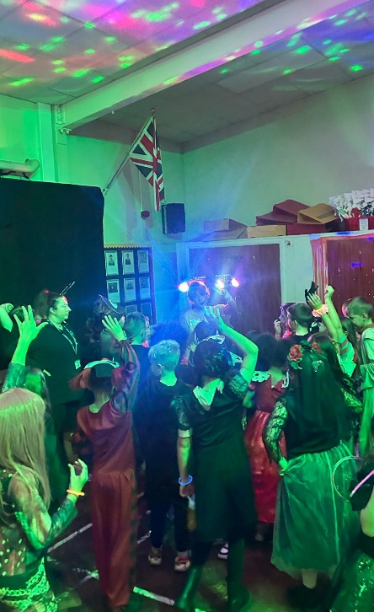
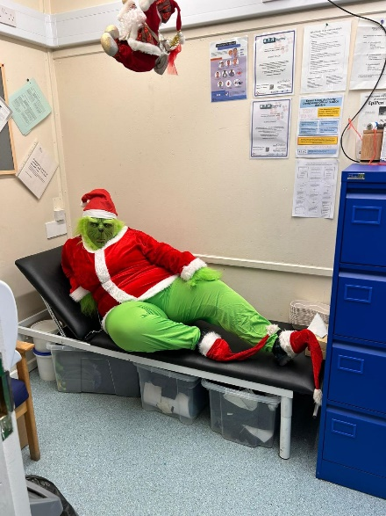
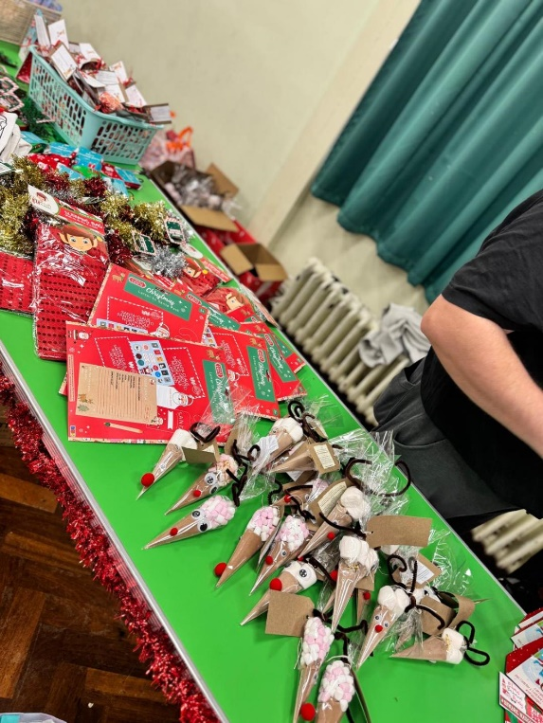
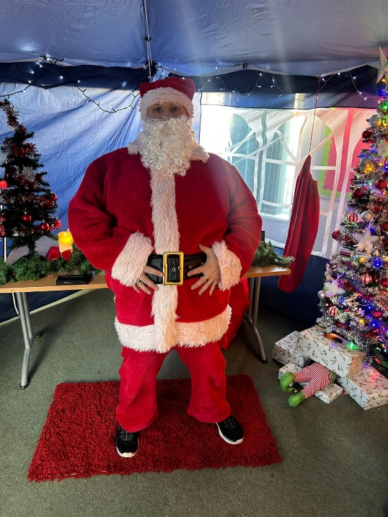
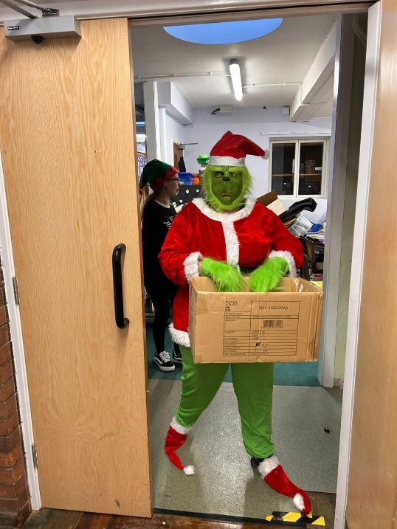
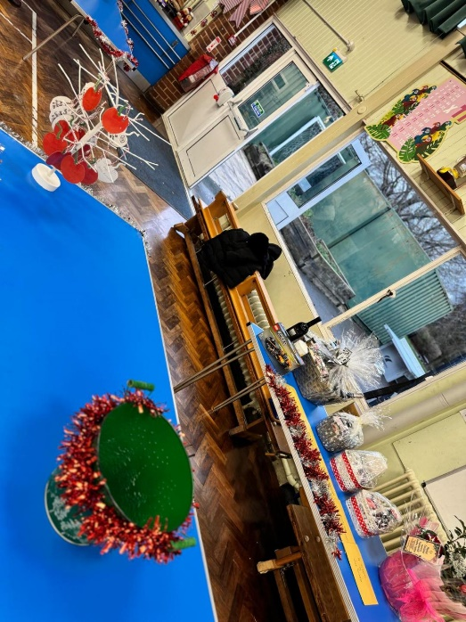

Slide 5
📚 What We Spent Money On 📚
📖 Books for Attendance Prizes
Rewarding brilliant attendance!
Cost: £17.05
🎬 Movie License
Couldn't use it this year, but we'll try again!
Cost: £104.36

Slide 6
💖 THANK YOU! 💖
A HUGE thank you to all our wonderful parents, carers, volunteers, teachers, and children who helped make this year so successful!
Every item bought and every smile made a difference!
Together, we're creating beautiful memories for our children ☺

